Slide 1
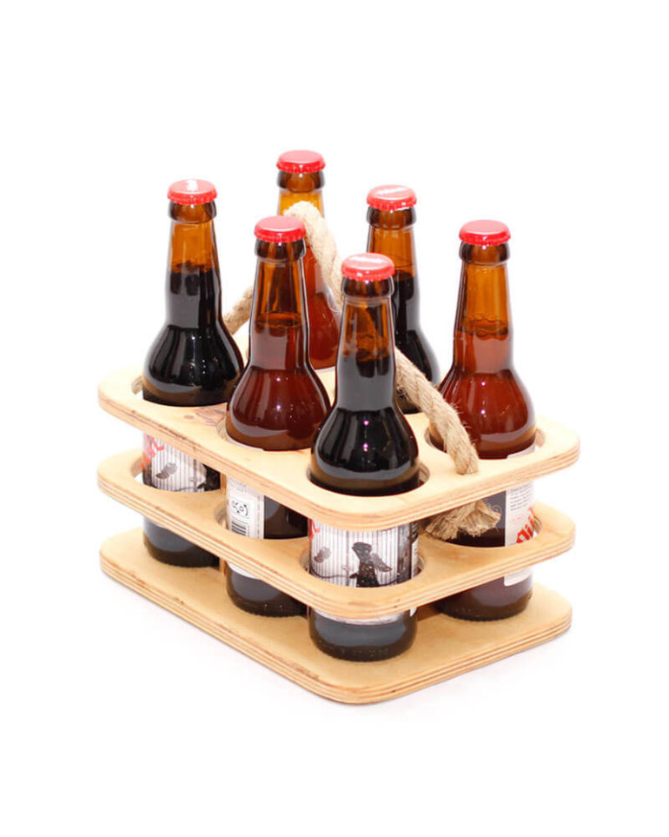
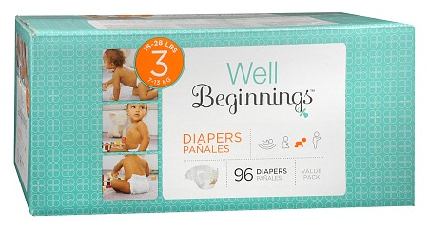
Recommendation Systems
Eindhoven Data Science
Eindhoven Data Science

Slide 2
Overview
Part I
Introduction
Collaborative recommendation
Cold start
Content-based recommendation
Knowledge-based recommendation
Part II
Task Description
Code example
Eindhoven Data Science Recommendation Systems

Slide 3







Introduction
Eindhoven Data Science Recommendation Systems

Slide 4
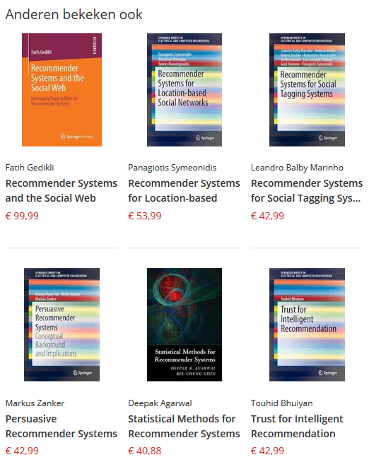
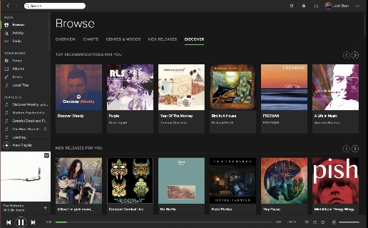
Examples
Eindhoven Data Science Recommendation Systems

Slide 5
Collaborative recommendation
Identify users who share the same interests.
Identify items that has the same ranking patterns.
Key idea
If users have similar history they might be interested in the same topics in the future.
If several products were evaluated in a similar way, the new product should have rating close to known ratings.
Eindhoven Data Science Recommendation Systems

Slide 6
User-based nearest neighbour recommendation
Given a ratings database and the ID of the current (active) user as an input, identify other users (sometimes referred to as peer users or nearest neighbours) that had similar preferences to those of the active user in the past.
 | Money Ball | Her | Imitation Game | Blade Runner | Beautiful Mind
Arend | 5 | 3 | 4 | 4 | ?
Bas | 3 | 1 | 2 | 3 | 3
Carol | 4 | 3 | 4 | 3 | 5
David | 3 | 3 | 1 | 5 | 4
Eugene | 1 | 5 | 5 | 2 | 1
Eindhoven Data Science Recommendation Systems
Notes:
Users a, b.
Products p.
Average for rating.
The Pearson Correlation is between -1 and 1. The -1 is for strong negative correlation, 1 is for strong positive correlation.
Coefficients for Arend is 0.85, 0.7, 0, -0.79.
The most similar users are Bas and Carol for the first user.
Beautiful Mind rating for Arend is 4.87 based on identified similar users.

Slide 7
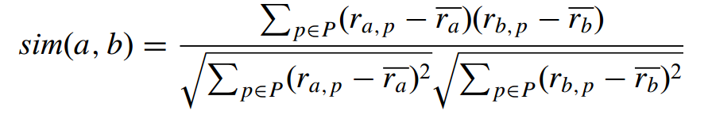
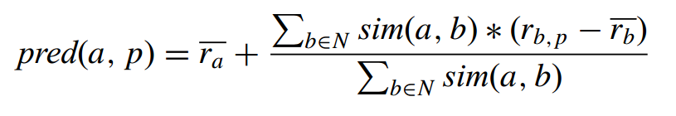
User-based nearest neighbour recommendation
Given a ratings database and the ID of the current (active) user as an input, identify other users (sometimes referred to as peer users or nearest neighbours) that had similar preferences to those of the active user in the past.
 | Money Ball | Her | Imitation Game | Blade Runner | Beautiful Mind
Arend | 5 | 3 | 4 | 4 | ?
Bas | 3 | 1 | 2 | 3 | 3
Carol | 4 | 3 | 4 | 3 | 5
David | 3 | 3 | 1 | 5 | 4
Eugene | 1 | 5 | 5 | 2 | 1
Eindhoven Data Science Recommendation Systems
Notes:
Users a, b.
Products p.
Average for rating.
The Pearson Correlation is between -1 and 1. The -1 is for strong negative correlation, 1 is for strong positive correlation.
Coefficients for Arend is 0.85, 0.7, 0, -0.79.
The most similar users are Bas and Carol for the first user.
Beautiful Mind rating for Arend is 4.87 based on identified similar users.

Slide 8
Item-based nearest neighbour recommendation
Compute predictions using the similarity between items and not the similarity between users.
 | Money Ball | Her | Imitation Game | Blade Runner | Beautiful Mind
Arend | 5 | 3 | 4 | 4 | ?
Bas | 3 | 1 | 2 | 3 | 3
Carol | 4 | 3 | 4 | 3 | 5
David | 3 | 3 | 1 | 5 | 4
Eugene | 1 | 5 | 5 | 2 | 1
Eindhoven Data Science Recommendation Systems
Notes:
Ratings for Money Ball and Beautiful Mind are similar. Partial similarity for Blade Runner and Beautiful Mind.

Slide 9
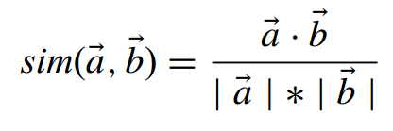
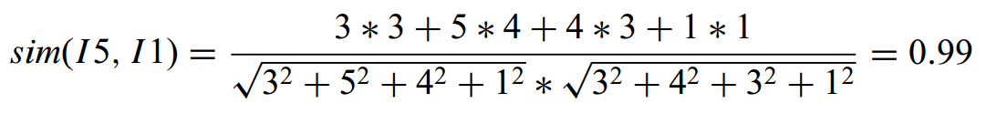
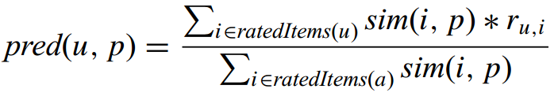
The cosine similarity measure
 | Money Ball | Her | Imitation Game | Blade Runner | Beautiful Mind
Arend | 5 | 3 | 4 | 4 | ?
Bas | 3 | 1 | 2 | 3 | 3
Carol | 4 | 3 | 4 | 3 | 5
David | 3 | 3 | 1 | 5 | 4
Eugene | 1 | 5 | 5 | 2 | 1
Eindhoven Data Science Recommendation Systems
Notes:
Point is the dot product.
Norm is the Euclidean length of a vector.
Similarity varies from 0 to 1.
Predict rating for user u and item p.
Rating for user u for similar item.

Slide 10
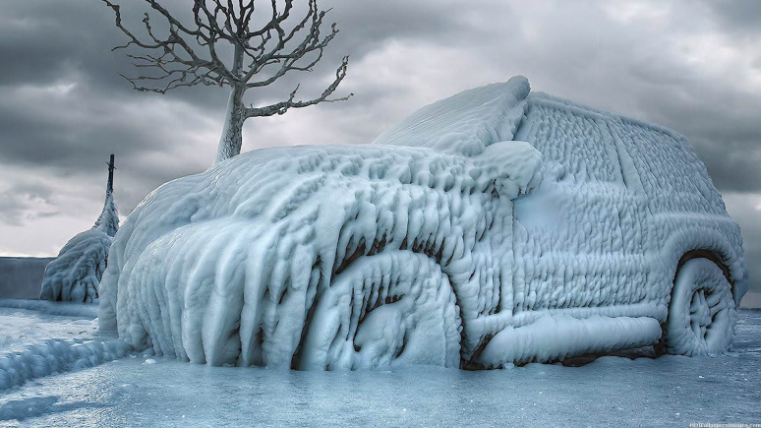
Cold start
When no or little information can be derived for a new user, it is very difficult to provide meaningful recommendations.
Standard approaches include
asking the user for a minimum number of ratings before the service can be used.
use demographic data such as gender, age, interests, country, friends.
give the most popular recommendations for a category.
present the top rated products.
use content information for new items.
Eindhoven Data Science Recommendation Systems
Notes:
In real applications matrices tend to be very sparse. Users give ratings only for a small fraction of available items.
Additional information about the users, such as gender, age, education, interests, or other available details.

Slide 11
Comparison
 | Scalability | Explanation | Coverage | Cold start | Performance
User-based | Bad when audience is large | Bad | Bad | Bad for new users | Need to get many users history
Item-based | Bad when many items are available | Good | Good | Bad for new items | Need to get current user’s history
Adopted from https://www.slideshare.net/xlvector/recommender-system-algorithm-and-architecture-13098396
Eindhoven Data Science Recommendation Systems
Notes:
Coverage good means that it can be computed in advance and shown to a user later.

Slide 12
Content-based recommendation
Identify items that have similar features.
Key idea
Find similarities between different items based on the set of features.
Eindhoven Data Science Recommendation Systems
Notes:
For the collaborative recommendations only ratings are employed. It is cheap, because no additional analysis and manual content updates are required.
Take information from a user profile and from an item descriptions and find a match between them.
Recommendations can be generated even for a one single user.
Common attributes are usually available.
It is difficult to get qualitative features, since they can be specific.

Slide 13
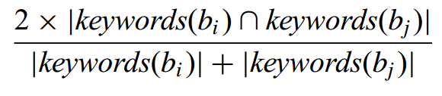
Content representation and content similarity
Explicit set of features for each item.
Rolling Stone's 500 Greatest Albums of All Time
Number | Year | Album | Artist | Genre | Subgenre
1 | 1967 | Sgt. Pepper's Lonely Hearts Club Band | The Beatles | Rock | Rock & Roll, Psychedelic Rock
2 | 1966 | Pet Sounds | The Beach Boys | Rock | Pop Rock, Psychedelic Rock
3 | 1966 | Revolver | The Beatles | Rock | Psychedelic Rock, Pop Rock
4 | 1965 | Highway 61 Revisited | Bob Dylan | Rock | Folk Rock, Blues Rock
5 | 1965 | Rubber Soul | The Beatles | Rock, Pop | Pop Rock
6 | 1971 | What's Going On | Marvin Gaye | Funk / Soul | Soul
7 | 1972 | Exile on Main St. | The Rolling Stones | Rock | Blues Rock, Rock & Roll, Classic Rock
8 | 1979 | London Calling | The Clash | Rock | Punk, New Wave
9 | 1966 | Blonde on Blonde | Bob Dylan | Rock, Blues | Folk Rock, Rhythm & Blues
10 | 1968 | The Beatles ("The White Album") | The Beatles | Rock | Rock & Roll, Pop Rock, Psychedelic Rock, Experimental
Eindhoven Data Science Recommendation Systems
Notes:
The simplest example.
Explicitly given set of features.
Dice coefficient.

Slide 14
The vector space model
Boolean vector
D1 = [The, cat, chased, the, mouse]
D2 = [The, dog, chased, the, cat]
W = [The, chased, dog, cat, mouse]
V1 = [1, 1, 0, 1, 1]
V2 = [1, 1, 1, 1, 0]
Adopted from http://slideplayer.com/slide/4578663/
Eindhoven Data Science Recommendation Systems
Notes:
Boolean vector.
The same importance for each word.
Bias to long documents that naturally have more words.

Slide 15
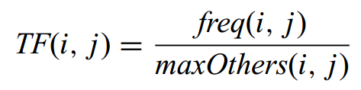
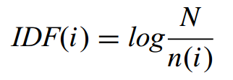

TF-IDF
Term frequency-inverse document frequency
Term frequency shows how many times keyword i appears in the document j.
Inverse document frequency of all the documents with the word i and all available documents.
Combine them together.
Eindhoven Data Science Recommendation Systems
Notes:
To prevent larger documents to have higher weight, some form of normalization is required.
How many times i appears in j divided the highest frequency of all other keywords not including i in the document.
Inverse document frequency aims to decrease the weights of frequently used words.
Text documents can be TF-IDF encoded in Euclidean multidimensional space.
The coordinates for each word is calculated with TD-IDF, and a document gets the place in the new system of coordinates.

Slide 16
Knowledge-based recommendation
Give information to new users with no or little history. User specifies the requirements and system gives the most appropriate recommendations.
Key idea
Interact with user that has blank or new profile for providing recommendations.
Two major types are constrained-based and case-based.
Case-based rely on similarity measures.
Constrained-based work with the explicitly defined set of rules.
Eindhoven Data Science Recommendation Systems
Notes:
Used for recommendations when user does something on a rare basis.
Concept drift.
Explicit requests.
Historic data is not required.
User must provide an input.

Slide 17
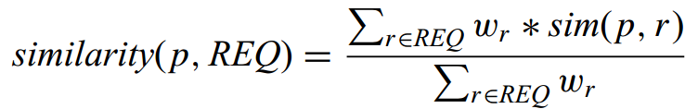
Distance similarity
REQ – requirements provided by a user for the p item.
sim(p, r) describes the distance to the requirements for each attribute p.
w is the importance weight or requirement r.
Eindhoven Data Science Recommendation Systems

Slide 18
Practical assignment
Make movie recommendations based
on MovieLens 100K data set.
Eindhoven Data Science Recommendation Systems

Slide 19
Description
MovieLens data sets were collected by the GroupLens Research Project at the University of Minnesota.
This data set consists of:
100,000 ratings (1-5) from 943 users on 1682 movies.
Each user has rated at least 20 movies.
Simple demographic info for the users (age, gender, occupation, zip).
This data has been cleaned up – users who had less than 20 ratings or did not have complete demographic information were removed from this data set. Detailed descriptions of the data file can be found at the end of ml-100k-README.txt file.
Format of u.data.
 | user id | item id | rating | timestamp
Example 1 | 196 | 242 | 3 | 881250949
Example 2 | 186 | 302 | 3 | 891717742
Eindhoven Data Science Recommendation Systems

Slide 20
Getting started
You can find the code to start at
https://github.com/RobRomijnders/EDS/blob/master/hack_10/Code/start.py
Eindhoven Data Science Recommendation Systems

Slide 21
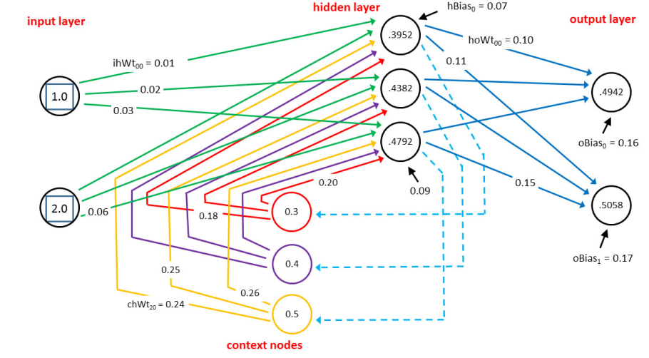
Next meetup
Recurrent Neural Networks
This hack will focus on implementing a Recurrent Neural Network (RNN). A RNN differs from a CNN, because it can take data with variable size as input and therefore it is ideal to analyse time-series, signals or text documents.
Date: 31st October, 2017
Eindhoven Data Science Recommendation Systems

Slide 22
Eindhoven Data Science
Questions?
The password for Wi-Fi is voorlopig .
Eindhoven Data Science Recommendation Systems

